Slide 1
West Lavington Parish Council
Community Resilience Plan
Community Action Cards
Revision 0

Slide 2
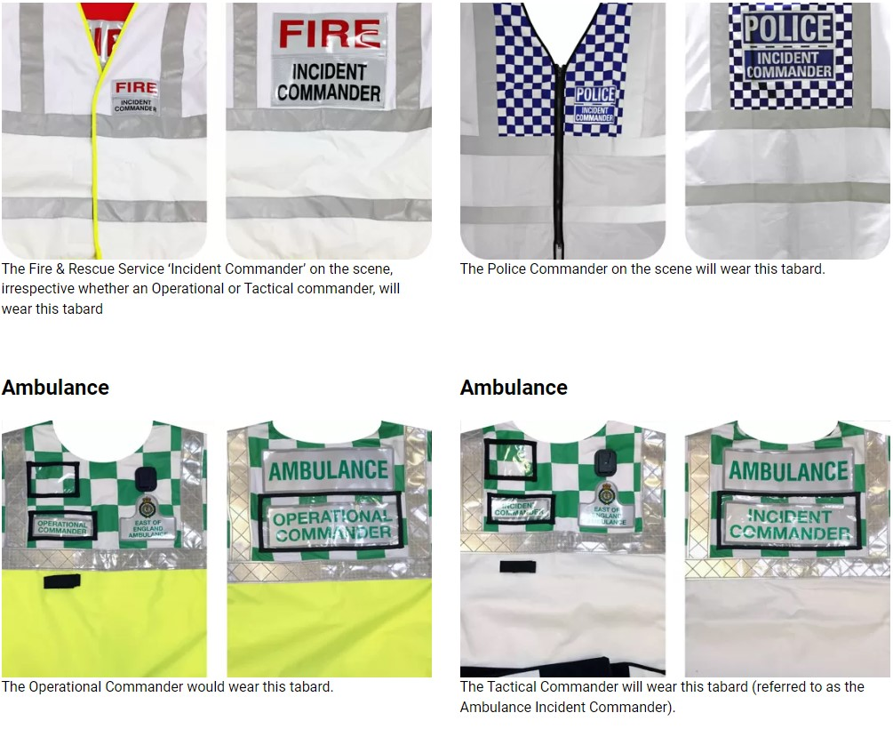
How to Activate a Place of Safety
There are 4 places of Safety, our primary is our Village Hall. Backups are All Saints (our CofE Church), St Josephs Catholic Church on the Cheverell Road near the crossroads and the Ebenezer Chapel opposite the Sandfield.
Contact a member of the Parish Council who will have keyholder details. Arrange with the keyholder to open the facility and call volunteers to come and help
Make sure you have the place of safety open before the next step
In the case of almost all events, fire, flood, road traffic collision, train or air disaster, the incident will be attended by the emergency services.
Send one member of the team to approach the incident commander at the scene. Incident commanders will be wearing a tabard (examples shown below).
Tell the incident commander that there is a place where people who are not casualties can find shelter, tell them where it is and how to contact you.
As soon as you have done this leave and get out of their way
The Objective
Our objective is to provide short term (24hours or less) shelter for those affected by an event.
These people will be upset and vulnerable and may even have lost their homes or loved ones.
Your job is to provide hot & cold drinks, warmth and shelter.
If people are displaced from their homes, relatives may arrive to collect them, if they need emergency housing job cards will tell you how to contact emergency housing at Wiltshire Council
If anyone leaves, please take their names and the addresses of where they are from and where they are going

Slide 3
Flood

Slide 4
Action Card - FLOOD
Identify pressure points from local experience
Recruit local volunteers at local pressure points
Deploy gel bags at these points
Local volunteers to remove debris in the autumn from drains
Use Social Media feeds to warn the community for Met Office Rainfall Alerts
Contact Volunteers in event of a localized flood
Warn residents using a WhatsApp Group
Surface Water Flooding
Likely to occur in autumn/winter with leaves and harvest litter blocking drains
Water main failure
Groundwater flooding is caused by the water table rising above ground level causing water to flow on top of the land. Risk in West Lavington Parish is low
Note: Dauntsey House Care home have identified the village hall as their evacuation point. Should they evacuate a second place of safety may need to be opened for local residents
River Flooding
Likely to occur after heavy rainfall or due to failure of dams or sluices
Work with Landowners & carry out routine inspections of Dam and river source
Contact Environment Agency & Wiltshire Council should river flood
If homes are threatened or A360 is blocked call 999 for Police and Fire Brigade
Overflowing sewers
Likely to occur after heavy rainfall overpowers capacity
Failure of sewer pumping stations
Pipe failures
Report each incident of contamination to Wessex Water and the Parish Council
Parish council to maintain a dialogue with Wessex Water and the Environment agency
In event of Flood call Wessex Water & Wiltshire Council

Slide 5
Action Card – FLOOD
Flood Volunteers – Surface Water Flooding
Wiltshire Council is the Lead Local Flood Authority (LLFA) for Wiltshire. Highway and land drainage is managed by the council's Highway Asset Management team who work closely with the Area highway engineers to ensure that the highway and land drainage operates effectively.
Wiltshire Council (out of hours)
For flooding, highway incidents and building control
Emergency 0300 456 0100
Non Emergency 0300 456 0105
Drainage & Surface Water Flooding
drainage@wiltshire.gov.uk
0300 456 0105
https://www.wiltshire.gov.uk/civil-emergencies-drainage
Burst water main
Wessex Water Leak stoppers: 0800 692 0692 Email: leakstoppers@wessexwater.co.uk
Wessex Water main contact
0345 600 4 600 (emergency 24 hrs a day)
River Flooding Environment Agency
Floodline: 0345 988 1188
Name | Contact | Location
xxx Flood Warden
xxx Flood warden
xxx Flood Warden
Peter West Flood Volunteer | 07768931679 | Duck St

Slide 6
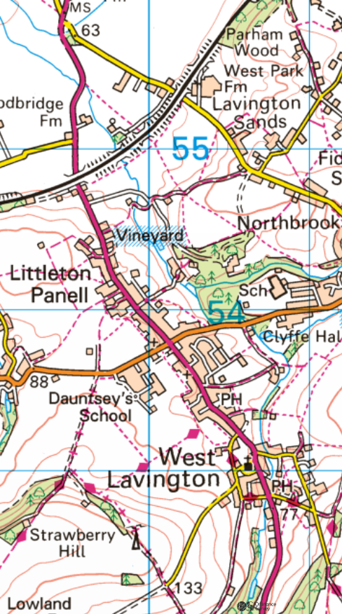
Action Card – FLOOD
Known pressure points
Surfacewater/storm
The Gun – junction of Rutts Lane & Church St
A360 corner - Junction of Duck St & Church St
Duck Street outside numbers 5 & 7
Russell Mill Lane
High Street outside the village shop
Lavington Lane adjacent to Hayfield site entrance
River
Junction of Church St & Rickbarton
d. Bottom of Russell Mill Lane
d
d
d
f
Sewer
Pumping Station in Duck Street
Bottom of Russell Mill Lane
e
Gel Sack Locations
b
c
c
Julia Ford Old Post Office Church Street
Al O’Rielly 7 Duck Street
a
a

Slide 7
Fire

Slide 8
Action Card - Fire
Call the Fire Service
Evacuate those in danger
Provide a place of safety
DO-NOT try and fight the fire
Open a Community Place of Safety to provide shelter
Wiltshire Council will offer emergency accommodation for those made homeless by fire
Provide shelter for those displaced temporarily
Assist those rendered homeless to contact friends, relatives or Wiltshire Council
Residential Fires
Persons displaced by evacuation from adjacent properties
Persons Homeless due to property damage by fire
Salisbury Plain or Farmland Wildfire
Call the Fire Service
DO-NOT try and fight the fire
Heavy smoke in the village? Communicate UK Health Security Agency Advice included in this document
Provide shelter for those displaced temporarily. Choose the Community Place of Safety that is farthest away from the fire
Report Salisbury Plain fires to Range Control
Report Farmland Fires to local farmers
Note: Dauntsey House Care home have identified the village hall as their evacuation point. Should they evacuate a second place of safety may need to be opened for local residents
Salisbury Plain Range Fires on Closed Ranges of Westdown or Imber
These areas are heavily monitored and controlled. Call Range Operations before reporting to the Fire Service as the military may be aware and have decided not to allow access to the Fire Service for operational reasons
Heavy smoke in the village? Communicate UK Health Security Agency Advice included in this document

Slide 9
Action Card – Fire
Fire Volunteers
Dorset and Wiltshire Fire and Rescue respond to all fires.
To report a Fire dial 999
To contact for non emergency matters 01722 691000 (during office hours) and call 0306 799 0019 (out of hours).
Salisbury Plain
The Defence Infrastructure Organisation, part of the MOD, manages fire response on Salisbury Plain.
Landmarc provides the support services by maintaining and delivering safe infrastructure and support services that promote sustainable and effective military training.
Landmarc National Service Centre
nsc@landmarc.mod.uk
+44 (0)800 022 3334
Range Operations Amesbury 01980 674951
Wiltshire Council
Homeless due to a disaster
Our service is a telephone and email service. Our telephone service is open from Monday to Friday, 9am to 5pm, closed Wednesday, 9am to 2pm.
0300 456 0106
You can also email Housing Solutions at homeless@wiltshire.gov.uk. Please tell us about your situation and leave a phone number to contact you on.
If you have a Housing emergency and the office is closed, contact the Emergency Duty Service on 0300 456 0100.
Name | Contact | Location

Slide 10
Action Card - Fire
The UK Health Security Agency have the following advice for those directly affected by smoke:
Smoke can irritate air passages, skin and eyes, resulting in coughing and wheezing, breathlessness and chest pain so individuals with pre-existing cardiovascular and respiratory conditions, such as asthma, should carry any necessary medication or inhalers with them at all times and seek medical advice if their symptoms worsen, by contacting their GP or NHS 111
With the ongoing high temperatures, it is important that you protect yourself from the smoke, whilst also keeping cool. The UK Health Security Agency advise the following:
avoid areas affected by smoke from the wildfire
stay indoors, keep your doors and windows closed, tune in to local radio station for advice and information if there is visible smoke from your property
where possible, make the most of any opportunities to increase ventilation when wind and other conditions allow. When there are smoke issues related to this fire, they do tend to be more at night
draw curtains to limit direct sunlight heating-up internal surfaces
use fans to recirculate air within the house to help keep cool
take a break from the heat by moving to a cooler part of the house (especially for sleeping)
wear lighter clothing
keep hydrated with cool drinks
check that central heating, lights and electrical equipment not in use are turned off
set any air conditioning (preferably fitted with a HEPA filter) to recirculate mode
open windows that are on the opposite side to the plume/smoke (when it is safe to do so), and when the air feels cooler outside than inside to get air flowing through the home, for example, at night
once the smoke has moved away, consider opening doors and windows to allow properties to cool down, being mindful of changing conditions and be aware that the smoke could return
If driving in smoky areas keep your windows wound up, air vents closed and switch off air conditioning systems to prevent drawing in outside air
Whilst causing short-term poor air quality, exposure to smoke from large-scale wildfires is unlikely to contribute to any long-term health effects. Any long-term risk to health from poor air quality will be based upon lifetime exposure, rather than the short-term acute exposure from this large-scale wildfire

Slide 11
Snow

Slide 12
Action Card - Snow
Provide a contact point for Community. Use Village Link 07598 947180 Link coordinator will contact a resilience councillor
Contact any resident registered as at risk
Use volunteers to provide essential Supplies
Village shop is able to provide hot food
Use volunteers to dig out or provide transport for emergency services workers to get to work (Fire, Ambulance, police plus Wiltshire Council gritting team)
Resilience volunteers to spread grit in key areas from grit bins
Ask resilience volunteers to check grit if heavy snow is forecast
Village Lanes at Risk
Steep Access or Isolated Position
Persons needing an ambulance or fire services must call 999 first
Ask Resilience volunteers to dig a path to patient location
Contact community first aiders to attend in case of ambulance delay
Use local resources to provide 4x4 transport to hospital if appropriate or to transport paramedic to patient location
Local resources must carry ropes, blankets, hot drinks and emergency provisions
Emergency Services unable to attend due to blocked roads
A360 and B3098 blocked as well as surrounding roads
A360 and B3098 open with village lanes blocked
Residents short of food
Residents unable to heat their homes
Use local resources 4x4 to shop or collect food
Local resources must carry ropes, blankets, hot drinks and emergency provisions
Open places of safety to provide a warm space for those affected
Hot food from the village shop or Churchill Arms

Slide 13
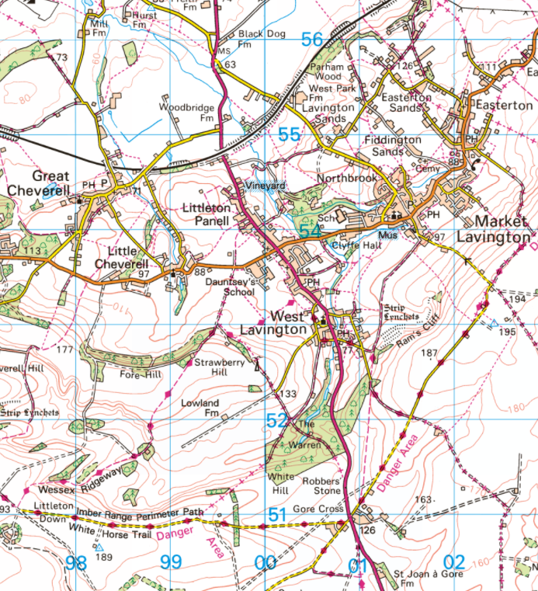
Gritting Routes for Snow and Ice
Roads Gritted
A360
Devizes to Salisbury Road
B3098
Westbury Road/Lavington Lane
Great Cheverell Bypass Route
Cheverell Road and Great Cheverell High Street
Secondary Council Salting route
Black Dog crossroads to Market Lavington via Spin Hill

Slide 14
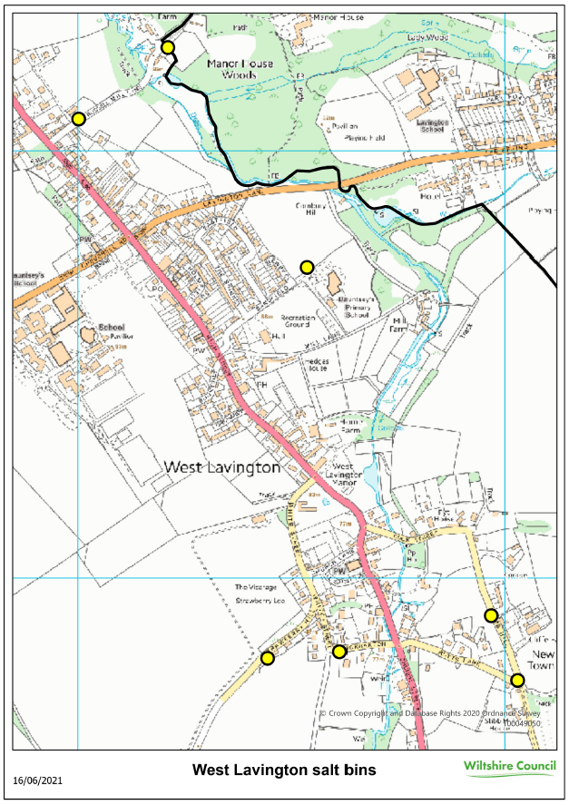

Slide 15
Action Card – SNOW
Snow Volunteers
Wiltshire Council
Maintain over 1600 salt bins located throughout the county.
They are available for both residents and the travelling public for use on public roads and footpaths
When using salt bins, you should work on the basis that 1 tablespoon of salt will cover around 1m²
You can report empty salt bins via My Wilts online reporting
If heavy or continuous falls are predicted a snow emergency will be called and the Emergency Control Centre established. In this event, the county's entire fleet of gritters will be mobilised and supplemented with the council's owned snow blades and blowers that are allocated to local farmers or contractors
Community Resilience
For the most part there is little external groups can do in snow. It is important that the community support each other.
You can expect ambulance delays so once an ambulance has been called, contact local first aiders when accidents occur to provide assistance.
Make sure your neighbours have heat, food and shelter
Name | Contact | Location
Peter West | 07768931679 | Duck St 4x4 available

Slide 16
Epidemic or Pandemic

Slide 17
Action Card – Epidemic or Pandemic
Public Health England and the Government announce both pandemic and epidemic.
Activate an emergency phone number to contact a Parish Council coordinator
Widely communicate support to the village
Compile a list of vulnerable people who need to stay isolated
Convene a special Parish Council Meeting using zoom or equivalent, to plan response following the communication of health guidelines.
Restricted movement of the population
Food & Medical Supplies
Provide a shopping service for vulnerable people within the community
Recruit additional drivers for link (Hospital/Doctor appointments)
Notes
Emergencies in the category have to be government or public authority led and will vary considerably depending on the nature of the emergency. Parish Council should maintain a practical, adaptable approach.
Meet regularly, at least weekly at the start of the emergency
Compile a list of help/assistance offered
Prioritise vulnerable people
Mobilise as many volunteers as possible

Slide 18
Loss of Utilities

Slide 19
Action Card – Loss of Utilities
Electricity
Supply failure for multiple properties for more than 8 Hours
Ensure that the power failure has been reported
Ensure that in the winter that people can heat their house and cook hot food
Consider opening a Community Place of Safety to provide a warm environment
Hot food available for the village shop or The Churchill Arms
Ensure that the supply failure has been reported
Ask Wessex Water to supply bottled water or a tanker
Contact residents across the village to see if there is water available and fill containers as needed
Water
Supply failure for multiple properties for more than 8 Hours
Sewerage
Ensure blocked sewers are reported
In the unlikely event that households cannot flush toilets consider opening a Community Place of Safety to provide toilet facilities
Loss of Broadband & Home phone
While this is not as serious as the other events, it can isolate people and should be escalated to the Parish Council
Ensure Openreach have been informed and have accepted the job. Broadband providers should confirm this to their customers
Inform the Parish Council so that they can monitor and work with Openreach for a timely repair

Slide 20
Action Card – Widespread Electrical Failure - Regional
Communication
It is vital to keep the community informed, while updates may be few the Village Hall should be staffed and open during the day to reassure people
Village Hall as a focal point for updates – Daily 5pm
Communication will come via the police or the RAYNET group who are mobilized by Wiltshire Council Resilience Leaders.
Monitor car radios that can receive analogue (FM or MW) for information
Set up a line of communication with care homes especially Dauntsey House as well as Dauntsey School
Provide warmth for the vulnerable & elderly
Fuel supplies will be impacted, knock on doors. People with Rayburns or open fires can help with warmth.
People with barbeques will be able to cook hot food
Heating
The need for heating will vary according to the weather. The key is to protect the vulnerable.
Food Supplies
To conserve fuel supplies ask people to combine into large groups to get shopping and supplies. One car with four people could shop together. Large vehicles could shop for multiple households.
With power down, credit card and cash machines will not work. Try and pool resources.

Slide 21
Action Card – LOSS OF ULTILITIES
Volunteers
Name | Contact | Location
Scottish & Southern Electricity Networks
Maintain the electricity infrastructure in our area, including substations
If you experience a power cut call 0800 072 7282
Water & Sewerage
Wessex Water are responsible for supply failures and blocked sewers
0345 600 4 600 (24 hours)
To find out if there are emergency works being carried out that affect supply enter your postcode on this map
https://www.wessexwater.co.uk/help-and-advice/emergencies/work-in-our-area

Slide 22
Animal Health

Slide 23
Action Card – Animal Health
Access to Farmland and/or Salisbury Plain
Animal & Plant Health Agency are the authority that manages animal health and will decide if access to land needs to be controlled
Assist with notifying the community
Assist with the placement of closure signs as requested
Farmers/Farm Workers might be confined to their premises and unable to buy food
Provide a contact point for Community. Use Village Link 07598 947180 Link coordinator will contact a resilience councillor
Mobilise volunteers who can collect and/or deliver shopping
Be aware that shopping may need to be delivered to the farm entrance from a public road

Slide 24
Action Card – Animal Health
Volunteers
Name | Contact | Location
Defra Rural Services Helpline on
03000 200 301 and choose the relevant options for APHA

Slide 25
Fuel Disruption

Slide 26
Action Card – FUEL DISRUPTION
Action required when two or more suppliers are unable to supply oil for more than one week
Most critical in the winter months
Householders are responsible for sourcing their own oil. The Parish Council will not assist in this
Consider opening Community Places of Safety to provide a warm environment for the elderly and vulnerable
Share supplier information on social media regarding fuel availability
Heating Oil shortages
Car Fuel shortages
When car fuel is unavailable, (queuing at garages means fuel is available so long queues are not a trigger).
Encourage the use of buses
Create a forum for car sharing to towns for food shopping and/or work
Encourage the sharing of fuel availability on social media

Slide 27
Action Card – FUEL DISRUPTION
Volunteers
Name | Contact | Location

Slide 28
Major Emergency

Slide 29
Action Card – MAJOR EMERGENCY
Its is important that volunteers do not interfere with the response of emergency services.
Open Community Places of Safety if requested by emergency services. Consult the page “How to activate a place of safety” within this document
Open Community Places of Safety to shelter people who must leave their homes
Mobilise volunteers to provide hot drinks and any additional help requested by emergency services
Ask that trained first aiders attend Community Places of Safety and are available if requested by emergency services
A major event such as a plane crash, train crash, road traffic collision with multiple vehicles and multiple injured persons, Incident with the armed services on Salisbury Plain, explosion, chemical spill etc. That affects the village and its residents and requires the response of all emergency services .
Mobilise volunteers, in such cases volunteers must be under the leadership of emergency services
Open Community Places of Safety to shelter people who must leave their homes
Persons assisting with machinery, such as chainsaws or farm machinery must be trained professionals. (ie. chainsaw operators must be professional tree surgeons or arboriculturists.)
When volunteers are requested by emergency services
Searching for lost or missing persons
To assist with transport
To assist with machinery
Extensive storm damage causing people to be homeless
Extensive storm damage with fallen trees blocking roads

Slide 30
Action Card – Major Emergency
Volunteers
Name | Contact | Location
Wiltshire Council (out of hours)
For flooding, highway incidents and building control
Emergency 0300 456 0100
Non Emergency 0300 456 0105
Resilience Councillors
Lead Resilience Parish Councilor | Peter West | 07768 931679 | 5 Duck Street, West Lavington
Resilience Parish Councilor | George Harrison | 07905 897551 | Littleton PannelL
Resilience Parish Councilor | Steve Laister | 07432 124059 | Duck Street, West Lavington
Provide contact details for places of safety keyholders and community volunteers

